Slide 1
An Evolution of a Mindset: A Historical Perspective on Sandia National Laboratories Fire Science Philosophy
Stanford ICME Seminar Series
January 30th, 2020 Stanford University
Stefan Domino, Ph.D.
Computational Thermal & Fluid Mechanics
Sandia National Laboratories SAND2019-15457 PE

Slide 2
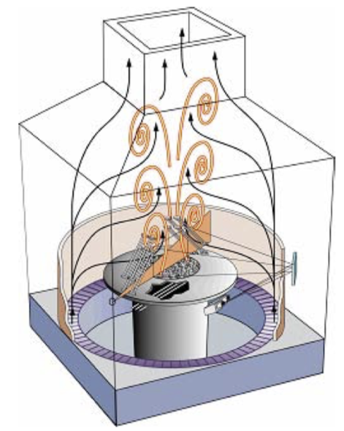
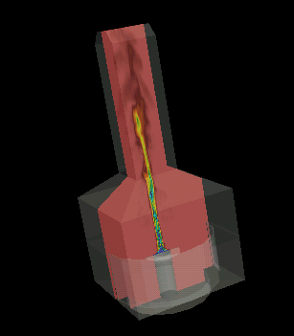
Quiescent Fire/Plume Physics Convergence
Solution Verification, i.e., mesh-independent results can be challenging
Sandia’s FLAME facility and experimental pedestal design drives dip in centerline vertical velocity (aleatory and epistemic uncertainty)
Turbulence modeling shown herein has no modeled term for production of turbulent kinetic energy due to buoyancy (nLES, Burton, CTRBrief 2009)
Therefore, core collapse is predicted only when small-scale RT and KH instabilities are resolved (sub-centimeter scale)
FLAME Facility
Hybrid/RANS-based: Tieszen, Domino, and Black, SAND, 2005
Computational Domain
Notes:
https://en.wikipedia.org/wiki/Uncertainty_quantification
Aleatoric uncertainty:
Aleatoric uncertainty is also known as statistical uncertainty, and is representative of unknowns that differ each time we run the same experiment. For example, a single arrow shot with a mechanical bow that exactly duplicates each launch (the same acceleration, altitude, direction and final velocity) will not all impact the same point on the target due to random and complicated vibrations of the arrow shaft, the knowledge of which cannot be determined sufficiently to eliminate the resulting scatter of impact points. The argument here is obviously in the definition of "cannot". Just because we cannot measure sufficiently with our currently available measurement devices does not preclude necessarily the existence of such information, which would move this uncertainty into the below category.^{[citation needed]} Aleatoric is derived from the Latin alea or dice, referring to a game of chance.
Epistemic uncertainty:
Epistemic uncertainty is also known as systematic uncertainty, and is due to things one could in principle know but do not practice. This may be because a measurement is not accurate, because the model neglects certain effects, or because particular data has been deliberately hidden. An example of a source of this uncertainty would be the drag in an experiment designed to measure the acceleration of gravity near the earth's surface. The commonly used gravitational acceleration of 9.8 m/s^2 ignores the effects of air resistance, but the air resistance for the object could be measured and incorporated into the experiment to reduce the resulting uncertainty in the calculation of the gravitational acceleration.

Slide 3
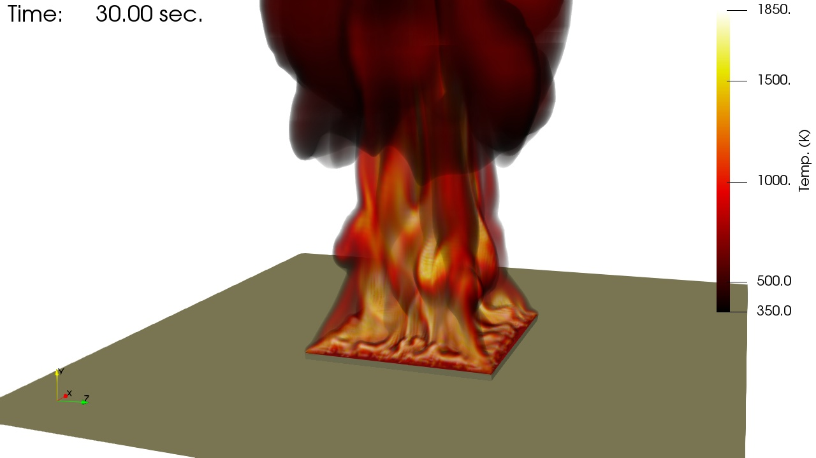
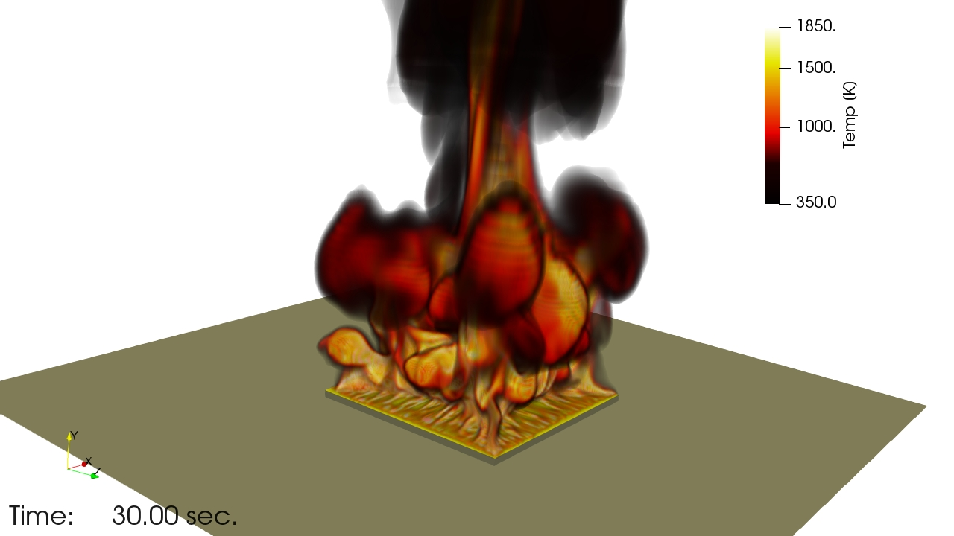
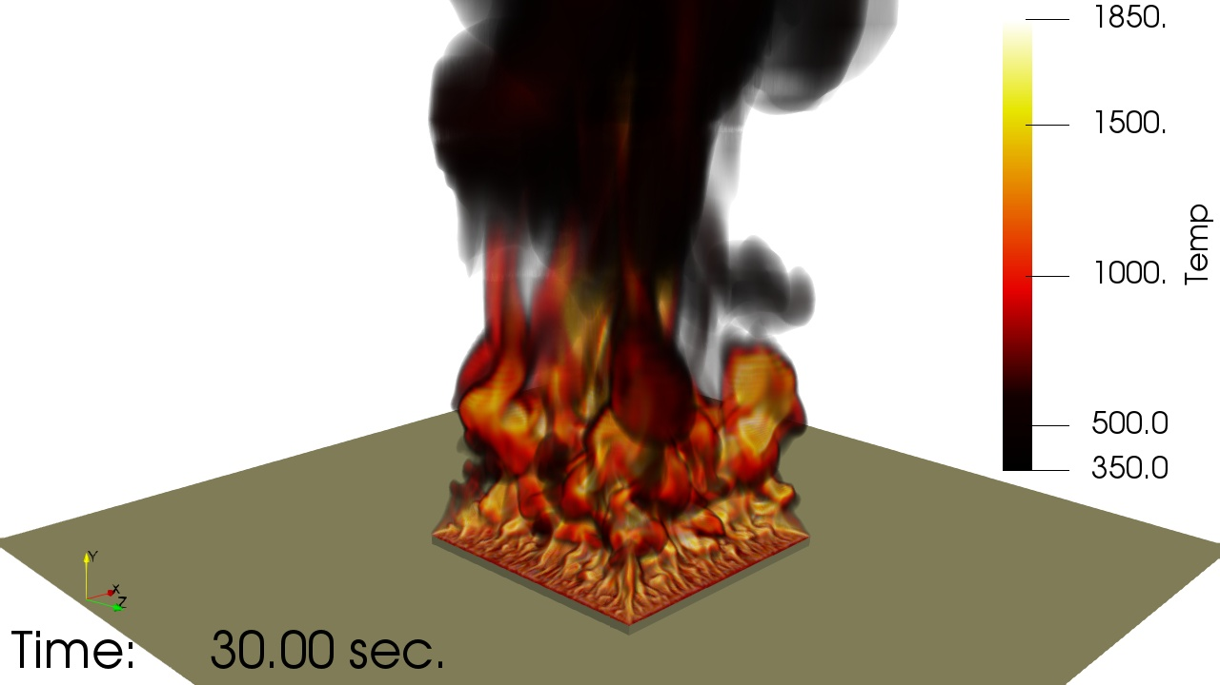
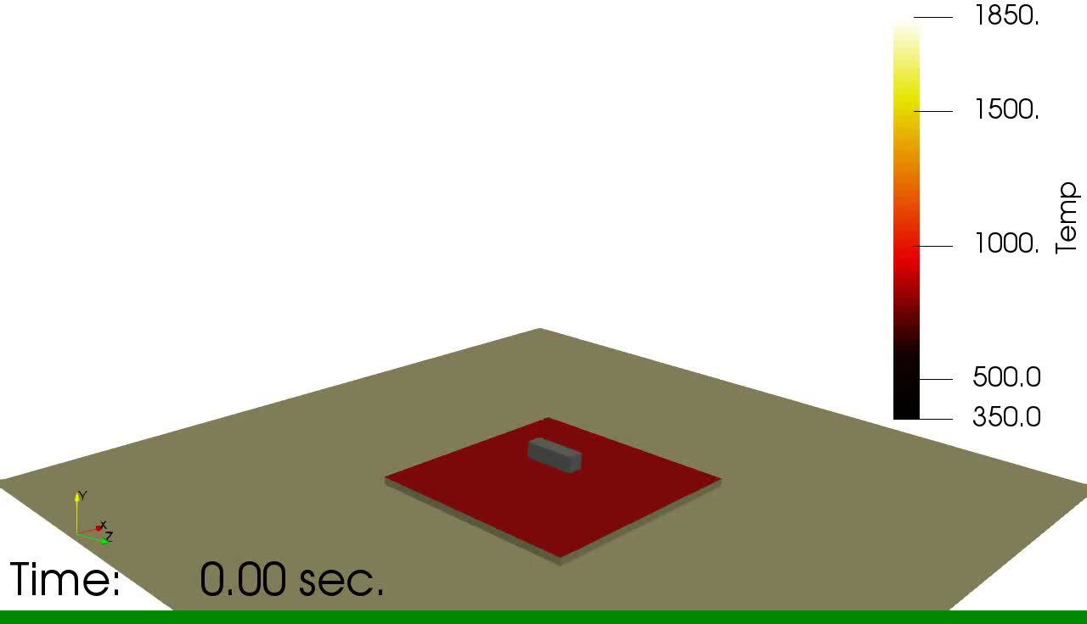
LES-based Solution Verification (Brown, et al., SAND, 2017)
Increasing mesh resolution captures core collapse and flame/entrainment fingering
10 cm
q”_{inc}= 95.4 kW/m²
7.5 cm
q”_{inc}= 91.3 kW/m²
5 cm
q”_{inc}= 73.6 kW/m²

Slide 4
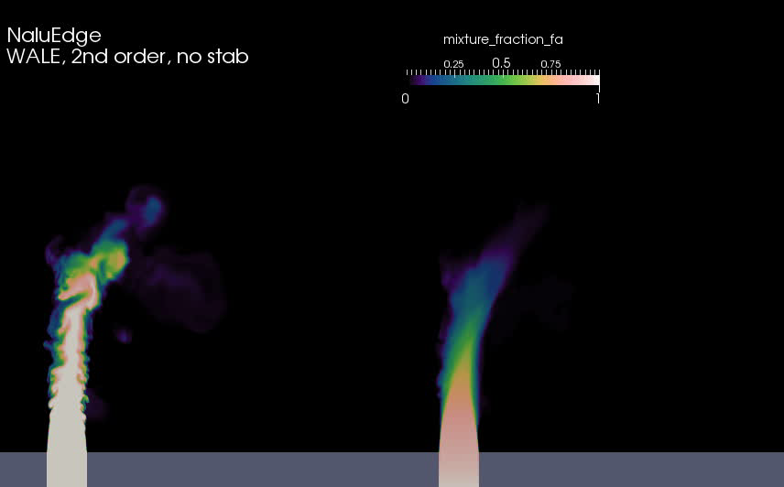
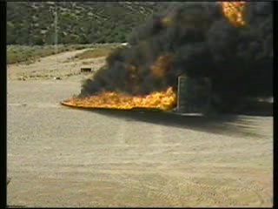
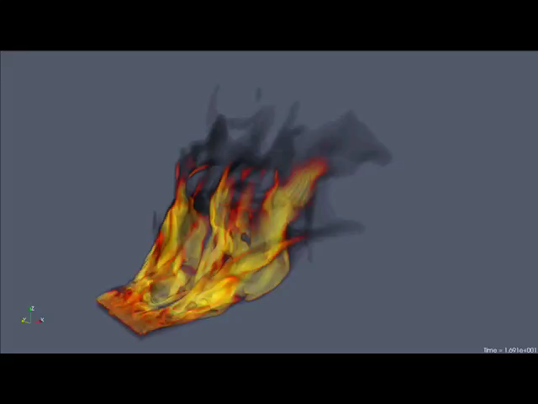
Evolution of a Mindset….. Crossflow
LES-based Su and Mungal (Re 5000) simulation (mixture fraction shading)
Fric and Roshco, JFM, 1994
Finding: The inclusion of a crossflow wind profile couples vorticity of the pool and streamwise momentum that drives the formation of column vortices, increases the importance of mixing and, therefore, convective loads on the object become more important
Change in mindset: Invest in validation use cases to highlight the importance of fire accident scenarios in the presence of crossflow
Ten meter (top) experiment (Nakos) and
three meter (bottom) simulation (Domino and Tieszen)

Slide 5

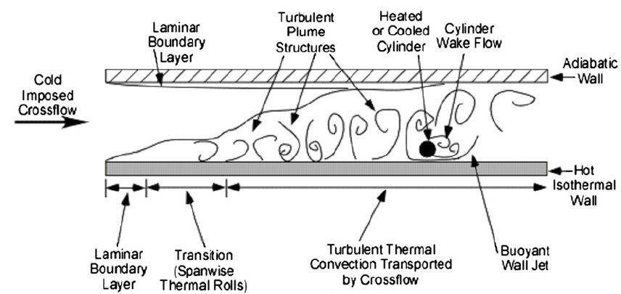
Turbulence Modeling in the Presence of Mixed Convection
Model Configuration: SNL-based Sean Kearney Experiment, “Experimental investigation of a cylinder in turbulent convection with an imposed shear flow”, AIAA, 2005
Present day RANS Conclusion: The presence of the heated bottom wall significantly challenged ability to predict the QoI (normal heat flux to cylinder)
Domino et al., CTRSP, 2016
Kearney experimental configuration
Laskowski et al., AIAA, 2007
RANS-based simulation (v2-f, k-e) study conducted by Laskowski et al., AIAA, 2007

Slide 6
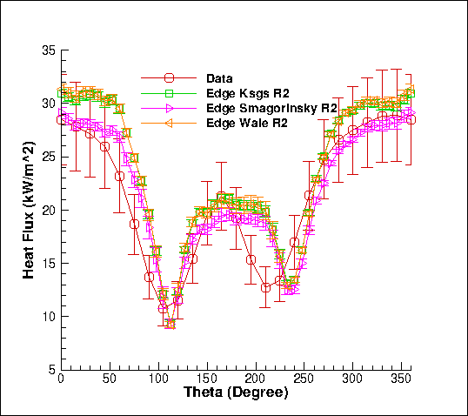
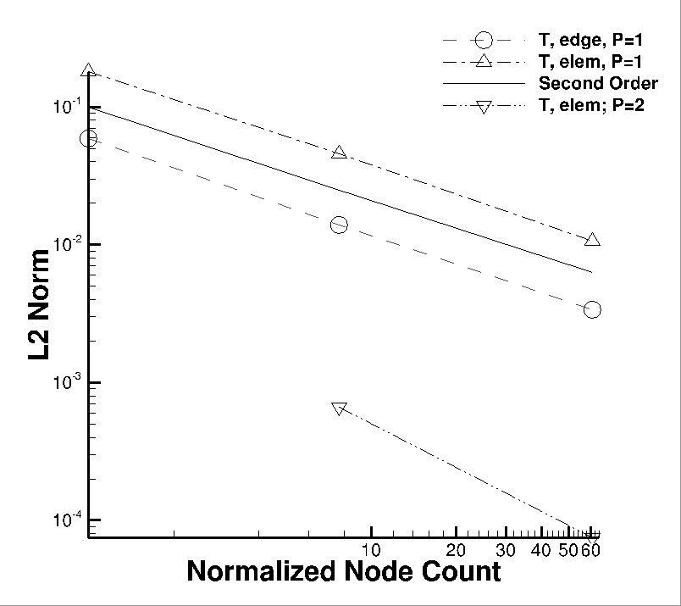
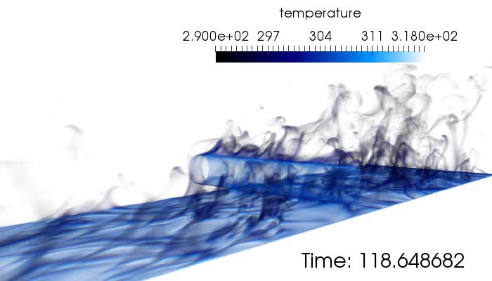
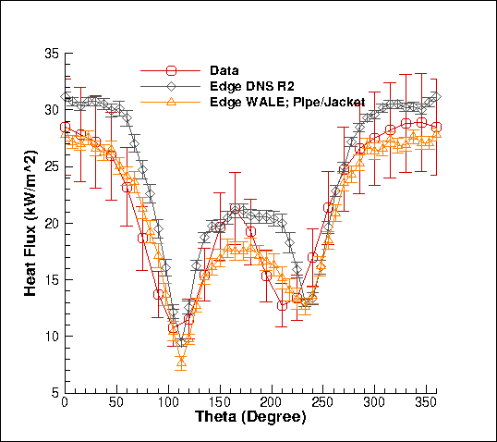
Research Thrust: High-quality LES-Based VVUQ Process
Numerical UQ
Established a sound LES-based verification and validation process (with uncertainty quantification) that includes the following attributes:
Definition of key physics, Phenomena Identification Ranking Table (PIRT)
Code implementation and verification
Validation including solution verification (meshes with converged statistics)
Structural uncertainty, i.e., model form, quantification
Physics assumptions
Structural UQ
Non-isothermal MMS
Physics UQ
10x
reduction
“An assessment of atypical mesh topologies for low-Mach LES”, Domino et al., Comp & Fluids, 2019)

Slide 7
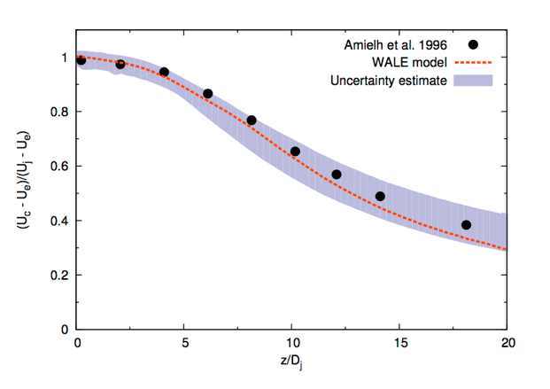
Research Thrust: Improved VVUQ: Automatic Structural Uncertainty
Previous LES validation studies, e.g., cylinder in x-flow, three models were implemented and tested (verified and maintained in the code repository)
Is there a more efficient approach? Yes! Eigenvalue perturbation of the SGS stress (extension of RANS-based approach: Emory et al., Phys. Fluids, 2017)
Barycentric triangle (see Lumley and Newman, J. Fluid Mech., 1977)
Open jet
Jofre, Domino, and Iaccarino, Flow Turb. Comb, 2018 (plane turbulent channel)
Jofre, Domino, and Iaccarino, Int. J. Heat & Fluid Flow, 2019 (turbulent axisymmetric jet)

Slide 8
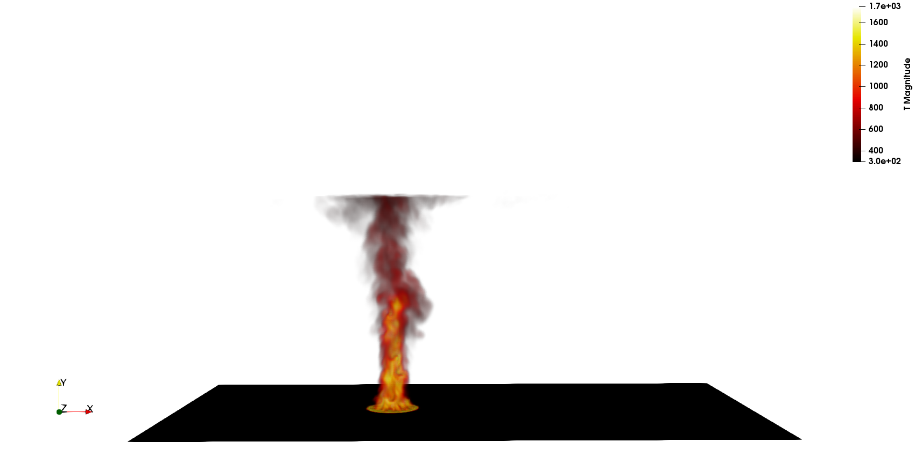
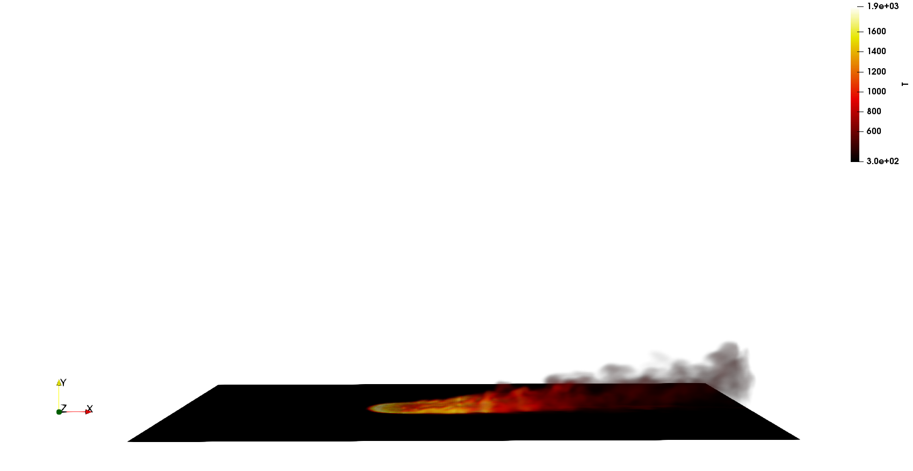
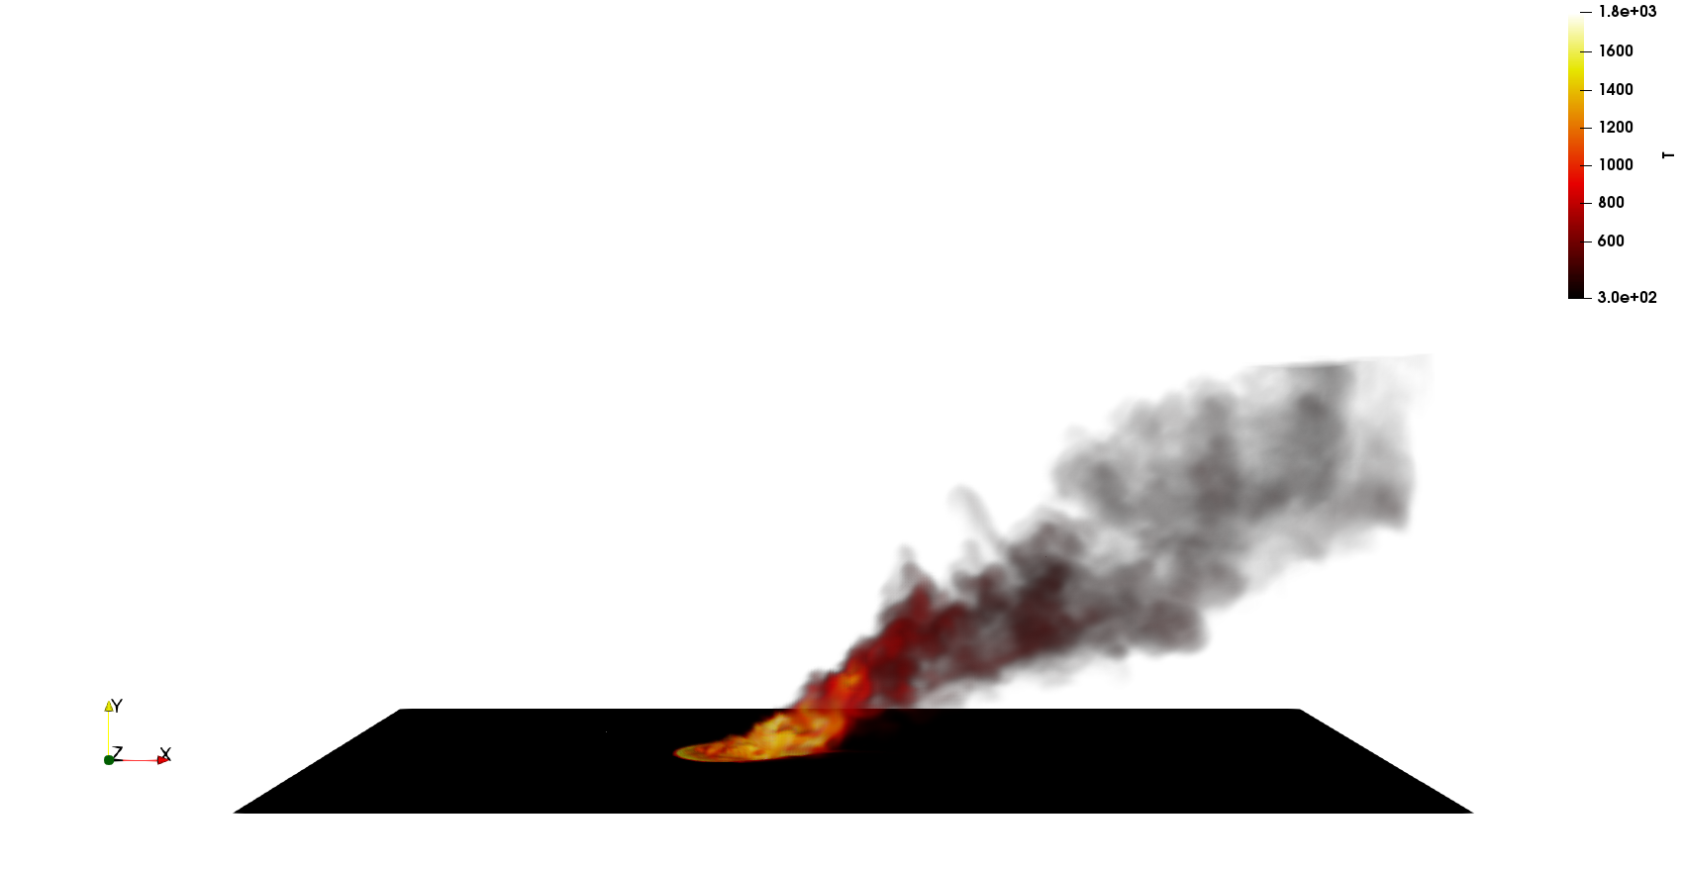
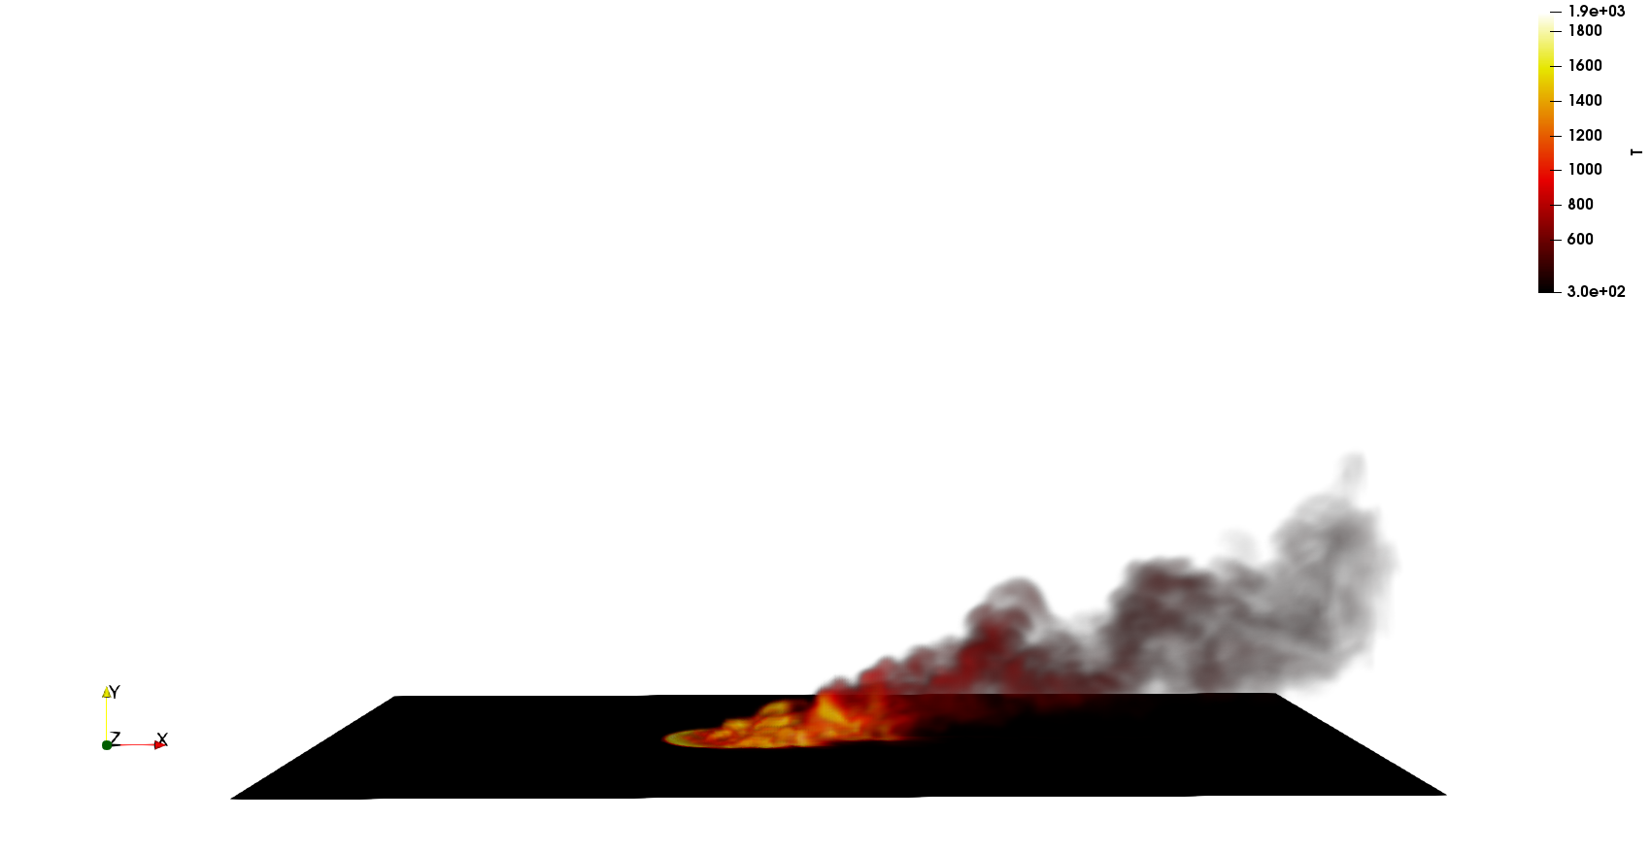
Research Thrust: Large-Scale Fire Dynamics in the Presence of Cross Flow
The coupling of crosswind with a hydrocarbon fire event drives large-scale column vortex formation – very similar to classic jet-in-cross flow behavior
Increased mixing yields increased radiative heat fluxes
Although bench scale efforts exist for quantities such as flame drag distance and tilt angles, none exist for this scale of interest, e.g., 10 meters and beyond
We (Domino and Scott, 2020 ASC V&V) are quantifying large-scale fire physics (Γ, θ, etc.) through theory (Mahesh, Annual Rev. Fluid Mech, 2013) and simulation (LES-based)
Wake vortices have never been realized in simulation (ABL/CVP interactions)
Deploy automatic LES-UQ methodology
Proposed CTRSP 2020
~0 m/s
q”_{r}= 180 kW/m²
5 m/s
q”_{r}= 250 kW/m²
10 m/s
q”_{r}= 380 kW/m²
20 m/s
q”_{r}= 360 kW/m²
10 m pool fire
LES-based numerical study with varying cross wind

Slide 9
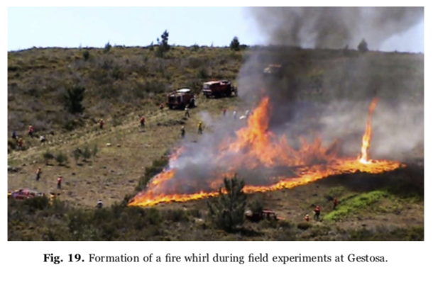
Evolution of a Mindset….. Whirling-like Flow
Fire whirls significantly increase pear radiative and convection loads to due increased mixing rate (>>200 kW/m²)
Phenomena can be rather common in real scenarios (see Fig 3 of Tohidi et al., Annual Rev. Fluid Mech., 2018), e.g., L-s, hills, etc.
Brush fire (Curtin Springs, Australia)
Pinto et al., Fire Safety J., 2017
Fire whirls from a 3-meter diameter pool in the Fire Laboratory for Accreditation of Modeling by Experiment, or FLAME, facility at Sandia National Laboratories. (Photo by Richard Simpson; A. Hanlin, lead experimentalist)

Slide 10
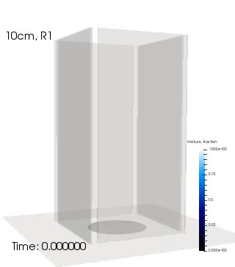
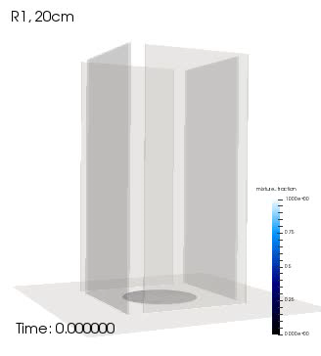
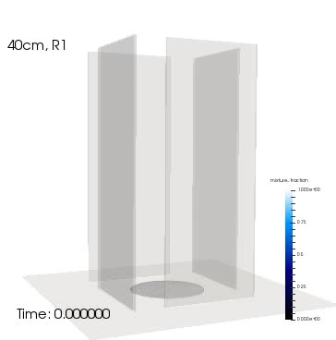
Research Thrust: LES-based Modeling Whirling-like Flow
Idealized chamber in which swirl is provided by selective wall placement (clockwise)
Buoyant (vertical) acceleration induces tangential entrainment, and, hence, internal circulation (Pinto et al., Fire Safety J., 2017)
Gap, g, varied between 10, 20, and 40 cm
Pinto et al, g = 10 cm, height = 6m )
Volume rendered mixture fraction

Slide 11
Kelvin Helmholtz Instability in a NM Sky
b
a
c
a: fully formed
b: breakdown
c: distant memory
O(60)s

